Slide 1
IBM Services Platform with Watson Software Defined Infrastructure Control (Densify)
Vicky Rose – Enterprise IT Transformation Advisor
Jean-Claude Dispensa – IBM Distinguished Engineer
Technology, Innovation and Automation – IBM Global Technology Services

Slide 2
Instructions
The purpose of this template is to provide a general structure for the IBM Services Platform with Watson training modules – particularly those focused a single consumable service from the platform
Suggested structure – topics to be covered
Suggested content – information we should attempt to provide within each topic
You almost certainly won't be able to cover every suggested item but at least cover each topic
Add pages as you see fit – I am not suggesting you only use one page per topic
Use the template as a guide rather than a constraint
Use this structure as a starting point if you do not have an existing presentation
If possible, align any existing presentation or content with the suggested structure
The aim is to provide a similar experience for each topic (but not to require you to recreate everything)
Supplement or adapt existing materials as necessary to cover the suggested content
Where one exists, the corresponding SIH East “Solution Nugget” has been provided as a potential starting point
I suggest you select content you think is suitable and copy into this template
Ensure that any guidance is applicable globally (update any references that are specific to AP or Japan)
The recorded presentation is expected to be approximately 45 minutes (60 minutes max)
Ensure adequate coverage of the topic for our target audience, but don’t feel obliged to present for 60 minutes
Provide links to further materials as appropriate (selecting those links / materials that you feel would be appropriate to include in a GDA+ SBB)
Delete this and any instructions or guidance before finalising your presentation

Slide 3
Contents
Overview – what does it do, what is included and what is not?
Value Proposition – why should a client want this?
Common Scenarios – what are the most common use cases and the solution selection criteria for each?
Delivery – what are the available delivery options and what dependencies exist on tools and infrastructure?
Solution Design – how do you design and cost the solution and any associated services / service levels?
Solution Guidance – what tips and lessons learnt do we have from prior work?
Further Help – who can provide further support and what additional resources are available?
Supporting Information – appendices with detailed supporting information

Slide 4
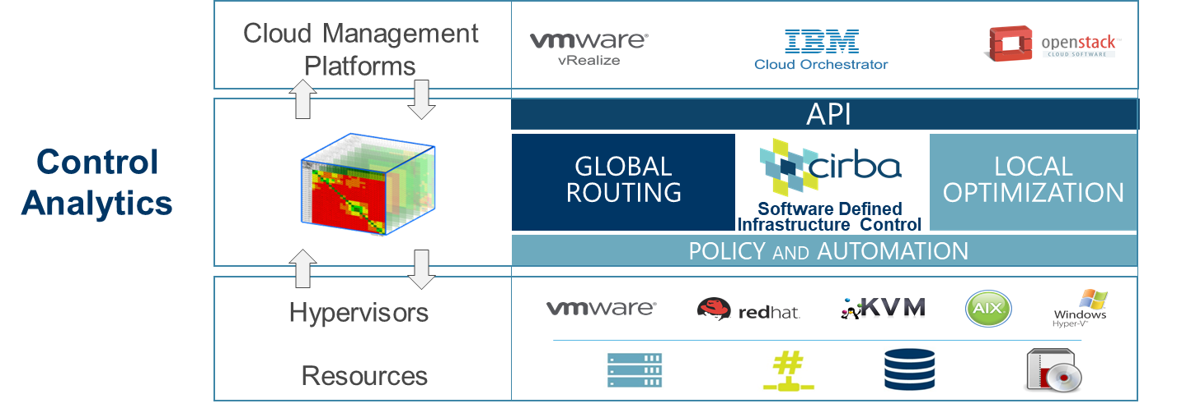
Capability Overview
Software Defined Infrastructure Control is a predictive analytics service that optimizes cloud environments in real-time, enabling customers to operate with less cloud cost, less infrastructure and better performing applications. IBM’s preferred tool is Densify, previously called Cirba.
It integrates with existing infrastructure management components to balance application demand and infrastructure supply to drive efficiency internally and in the cloud
It provides Automated real-time hosting decisions and placements, and reduce software license costs with smart VM placements.
SDIC is a combination of SaaS-based analytics and expert guidance.

Slide 5


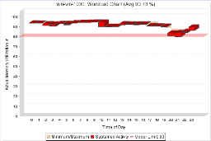

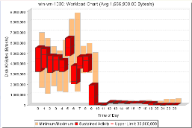

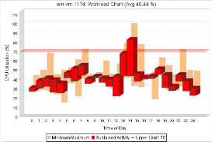

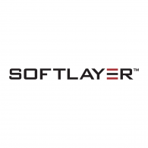





Under the Covers: Analytics Engine
Policy
Machine Learning & Multi-Dimensional Analytics Engine
Precise Optimization & Automation
Right Sized Cloud
Densified Virtual
Optimized Transform
Business & Functional Tags
Application
Demand
Patterns
Infrastructure
Characteristics &
Benchmarks
CPU
Memory
I/O

Slide 6
Scope
SDIC provides the following functions:
Optimises VM placement, increasing VM density to reduce waste while reducing risk of over-committing
Provides predictive analytics and automatable recommendations to
Optimize resource placement to ensure balanced workloads
Right-size VMs for CPU & memory, and identify idle VMs
Resize capacity at cluster and environment levels
Reduces software cost by reducing the number of CPUs needed to be licensed and moving VMs to specific licensed hosts (software license control is an add-on)
Helps in initial VM placement and its automation, even across multiple clouds
Includes a reservation feature which allows forecasting of future hardware and software spend
SDIC applies to the Midrange environments mainly :
Hypervisors supported - VMware, HyperV, KVM, PowerVM, Containers
Physical x86 (Windows & Linux) and Power.
Public Clouds ( BlueMix, AWS, Azure )

Slide 7
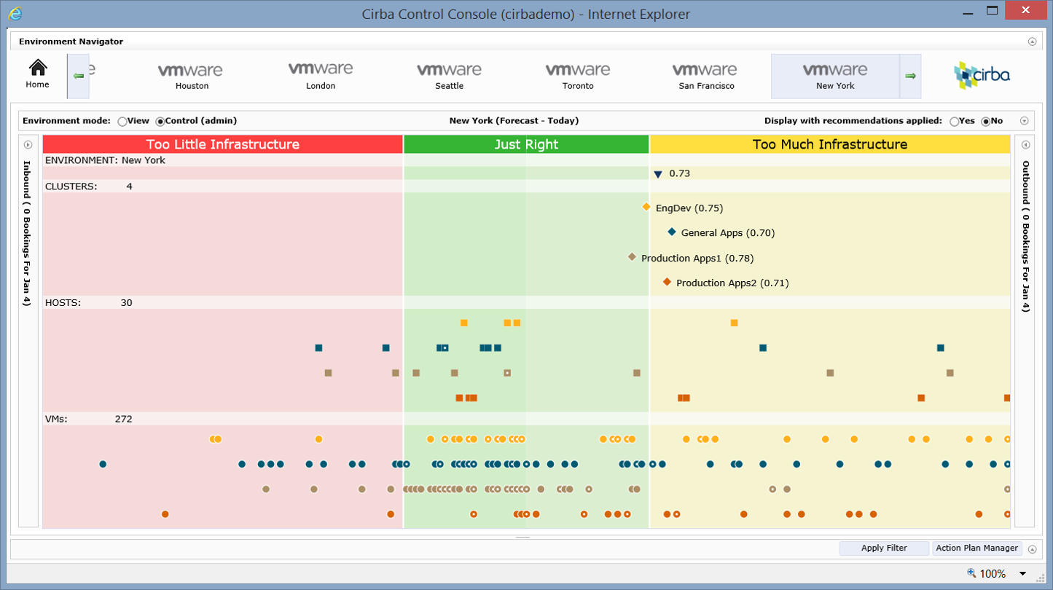


SDIC quantifies efficiency & risk
Risks
Inefficiencies
Clusters
Policy-Based
“Goal Posts”
Hosts
Guests

Slide 8
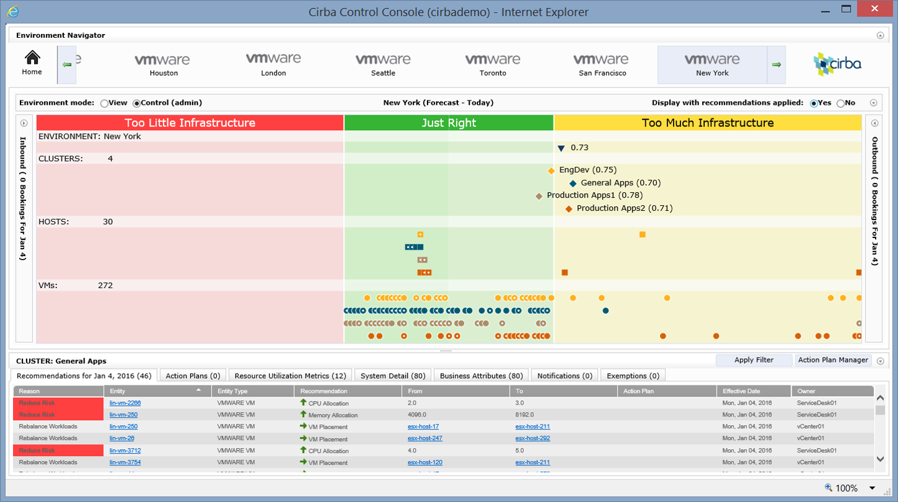
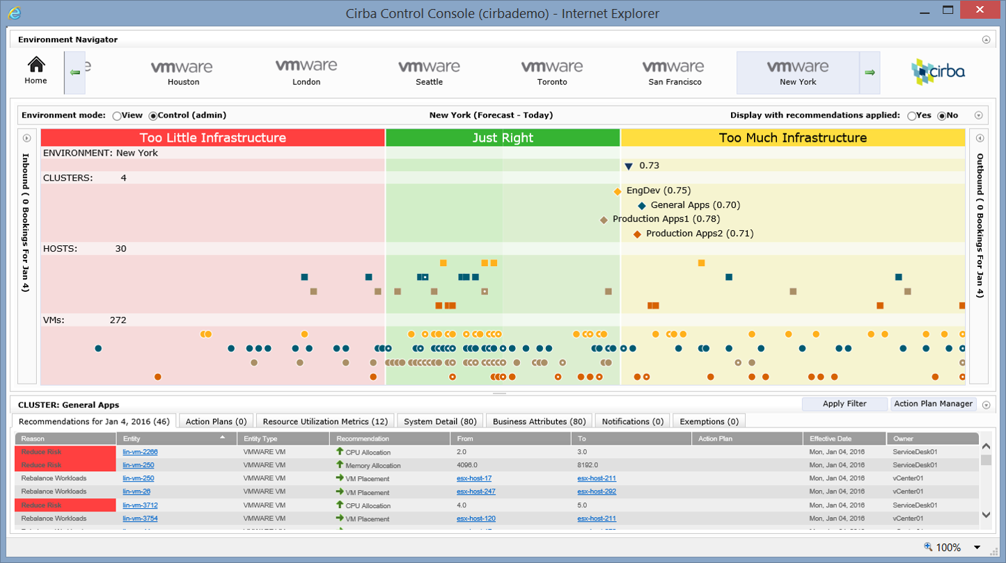
….and generates detailed plans to optimize
Freed Up Stranded Capacity
Reduced Operational Risk
Actions to
“Move to Center”

Slide 9
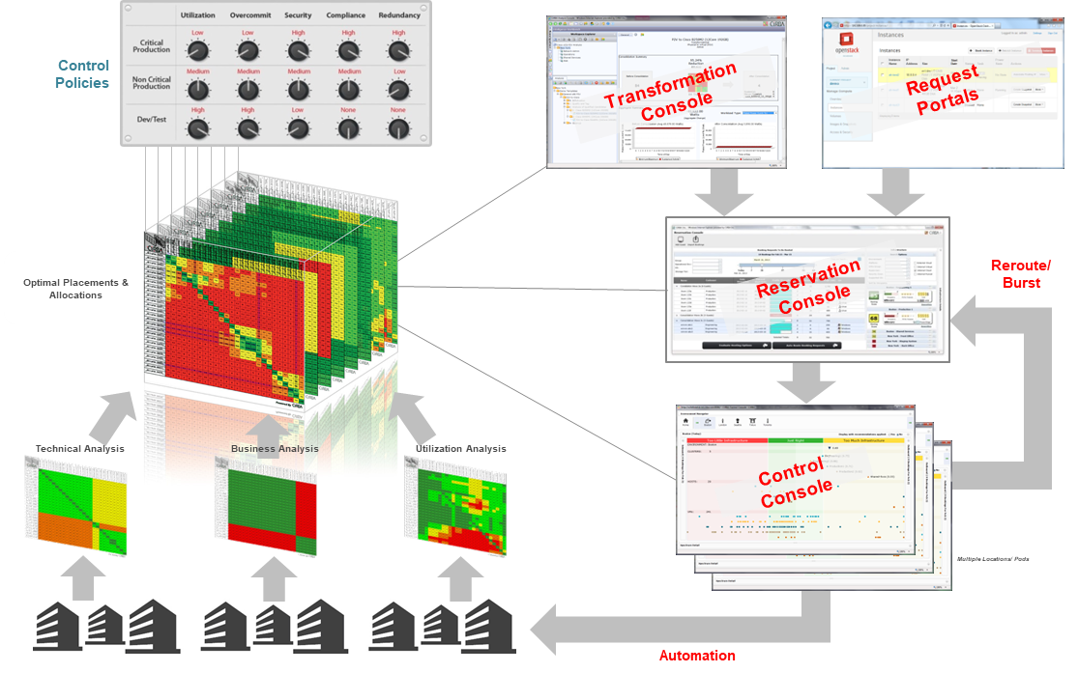
What reporting is provided?
SDIC provides a set of dashboards that will help the Operations teams take informed decisions on where and how to run their workloads in a most optimal manner based on pre-set or default best practices based set of policies

Slide 10
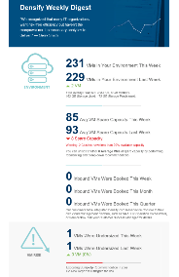
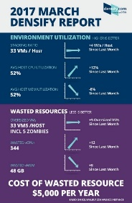

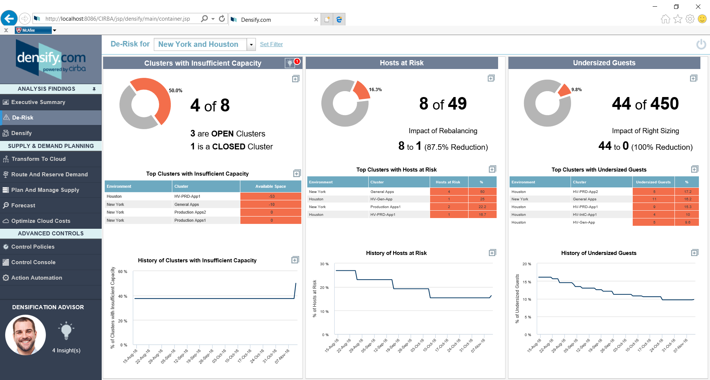
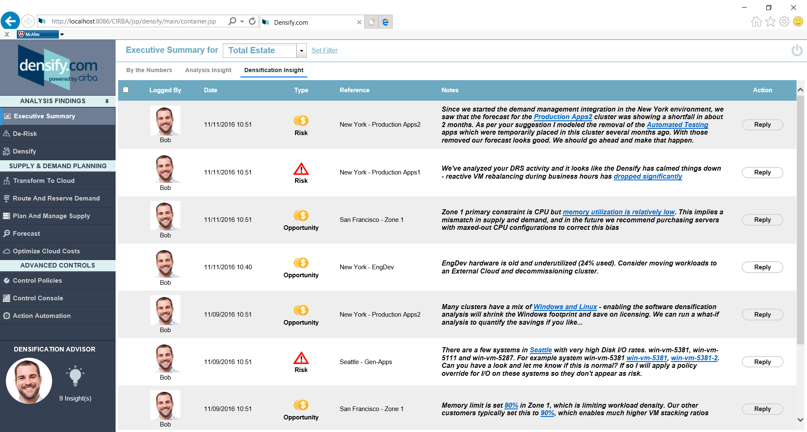

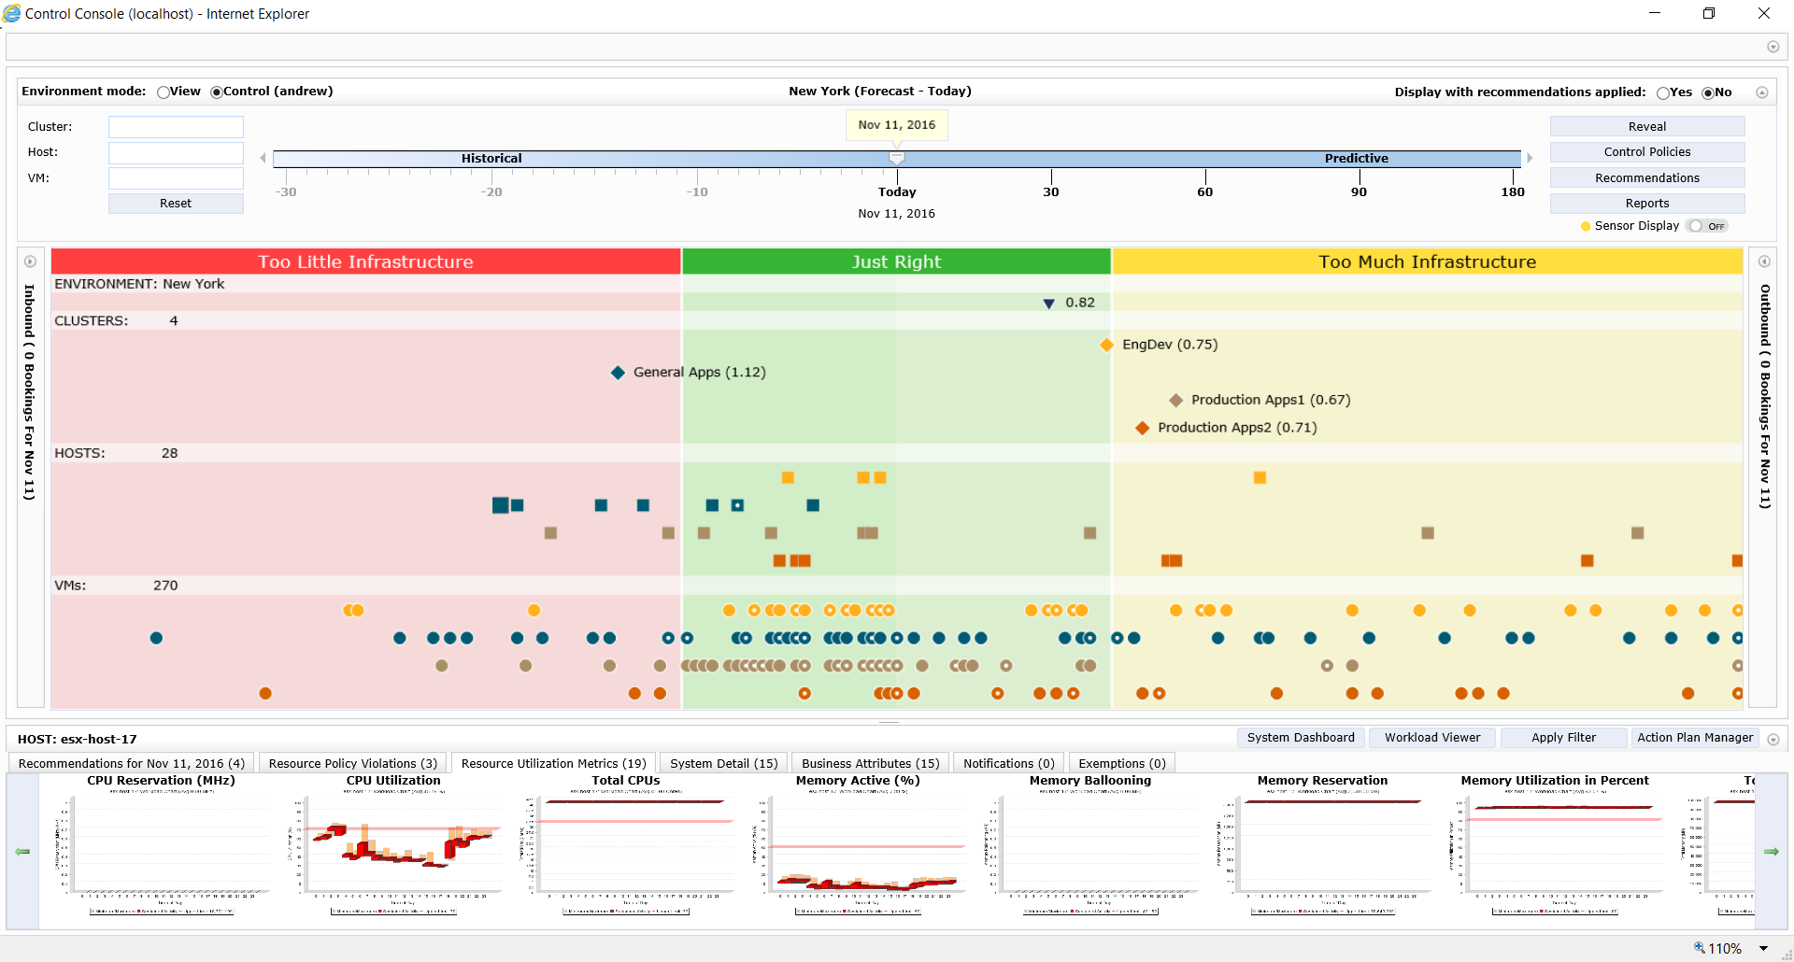
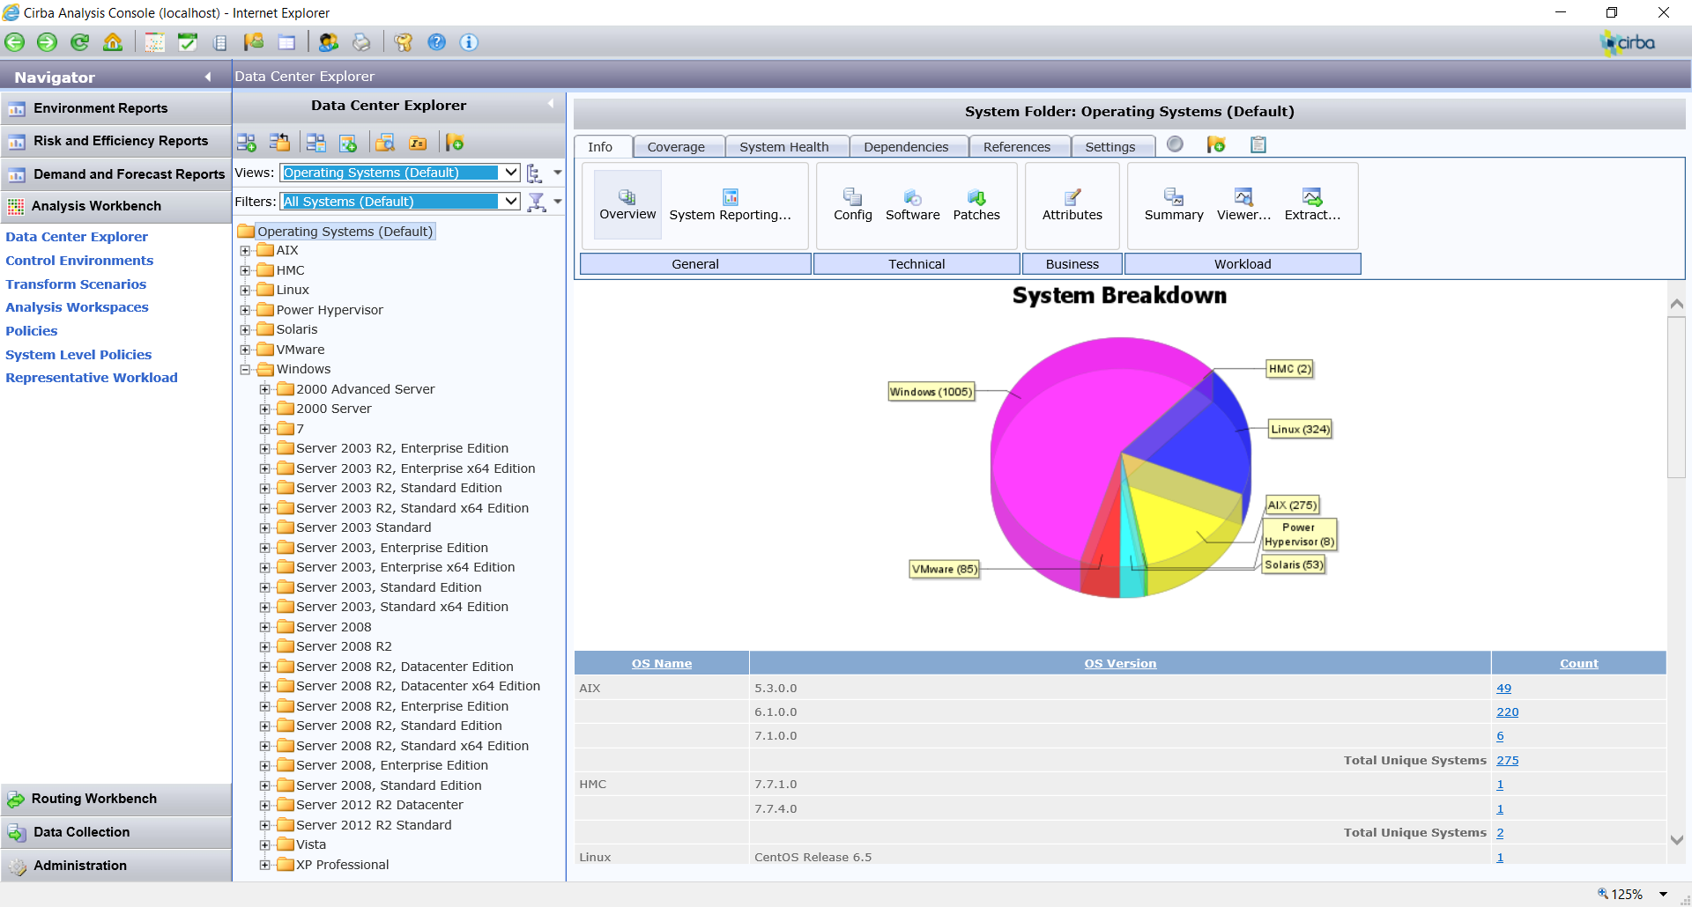

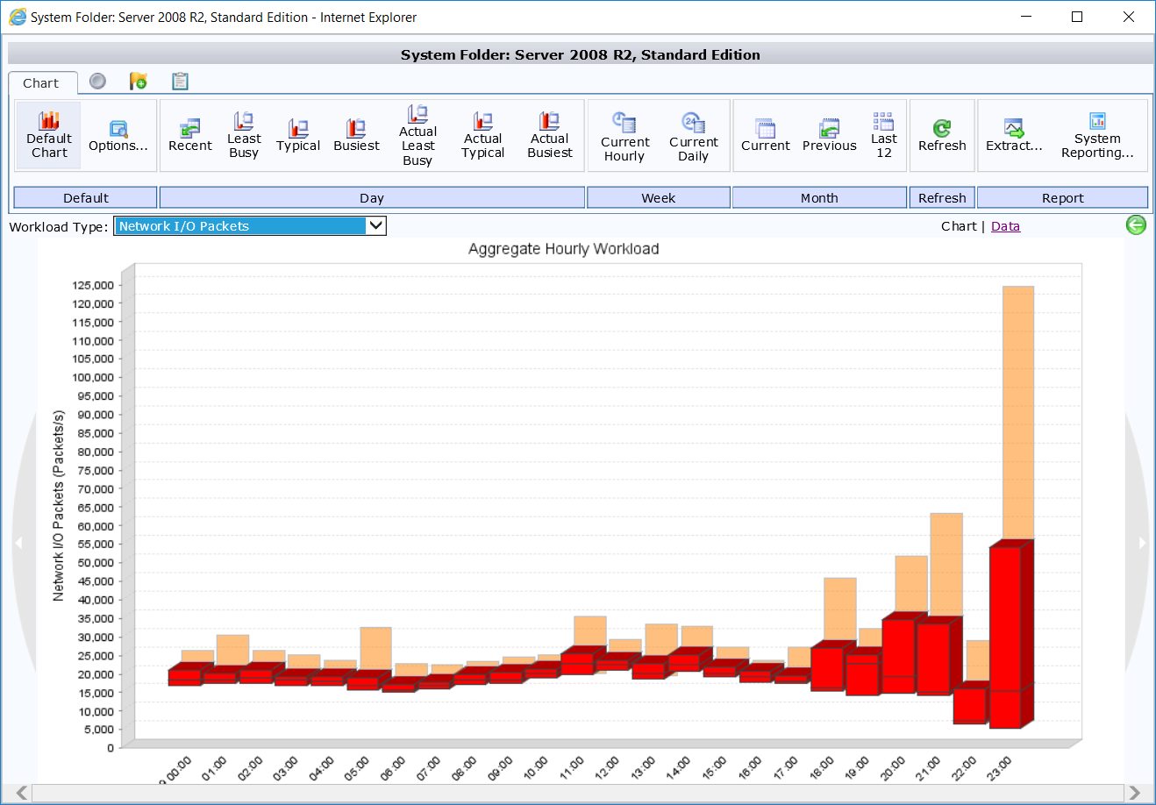
Progressive usage model
IT Executives
Daily/Weekly Digest
Monthly Report
IT Managers
Analysis Dashboards
Expert Insight
Capacity Managers & Data Scientists
Control Console
Data Center Explorer

Slide 11






Key outcomes
De-risks
Anticipates risk and proactively places workloads and resources to avoid shortfalls, reducing motioning and performance issues
Reduces costs
Reduces cloud spend by 20-80%, increases VM density by an average of 48% and cuts software license cost by 55%
Automates
Automated determination of VM placements and resource allocations, automated routing of new applications, and detailed capacity measurement and reporting
Transforms
Analyzes transformations to public cloud, containers and on prem virtual
Adds to your team
Human expert included with every subscription

Slide 12
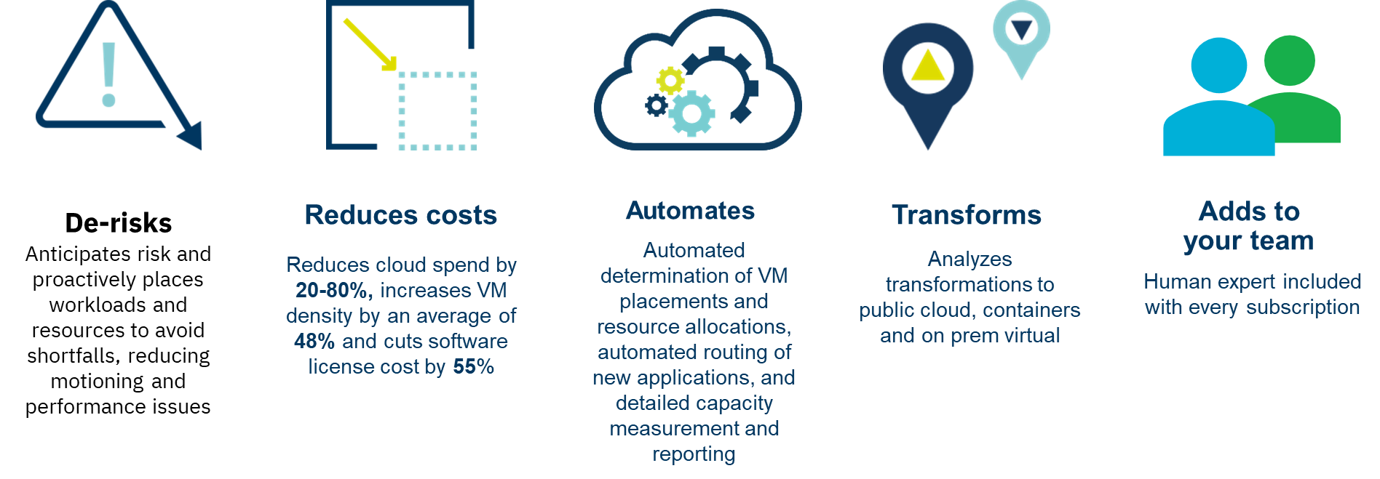
Value Proposition
Cost Reduction is the most compelling reason to deploy SDIC* (average figures):
Reduces cloud spend by 20-80%, Increases VM density by 48%, Reduces hardware requirements by 33%
Reduces hybrid cloud cost by 46%, Reduces software license cost by 55%
Reduces risk of performance issues using predictive analysis, making recommendations to avoid future resource contention and optimally place workloads
Can automate VM placement and resource allocation, reducing effort to manage the cloud
Provides analysis for virtualised environments, public & private clouds and containers
Fast implementation – integrates with existing management infrastructure and no need for agent deployment

Slide 13
Common Usage Scenarios, Selection Criteria and Positioning
Large Server Migration and consolidation projects
prevents purchase of unneeded equipment and makes decisions on the best target for VMs
Cloud/Hybrid Cloud project
Can be a capacity planning tool in Hybrid cloud projects to ensure a right-sized cloud
Optimisation / Cost take out
Improved host density and VM right-sizing can provide significant cost savings
Steady state
is a means to optimize server capacity, particularly in large environments where GTS owns the assets, delaying potential hardware spend for growth and significantly reducing software spend
Ongoing
This is not just a single-use tool, but provides ongoing benefit by re-balancing existing workloads as conditions change and makes recommendations for new workloads being deployed

Slide 14
Delivery Model and Options
VMs can be either hosted on Public Clouds or in client’s Datacenters. Can also collect data from physical servers if needed.
SDIC is offered in 2 deployment models, SaaS and Dedicated on-premise.
The SaaS option should be the preferred option
When using the SaaS model, connectors are built on the client network to connect to the workloads and collect data through the consoles or hypervisors.
SDIC can also be deployed as a dedicated on-premise instance in the client’s datacenter
This requires implementation of Densify server, Database and other components
SDIC should be considered when client is running physical and virtual farms outside of a Cloud Management Platform and has a cost Optimization objective.
In environments where VMware vRA is already deployed and vROps is already being used to provide the same functions, it may not make sense to shift to SDIC. The cost of SDIC versus vROps based on the functional requirements of the client will be important to factor in.
SDIC provides best value if the client environment has multiple VM farms and expecting to grow fast. The ‘sweet spot’ is an environment of 1000 servers or more, but a minimum of 250 VMs is the starting point.

Slide 15

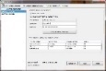
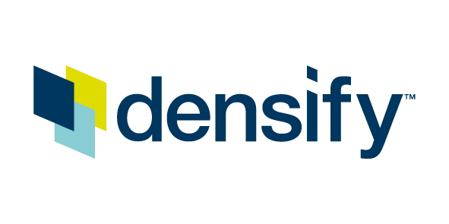




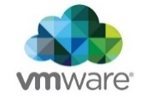

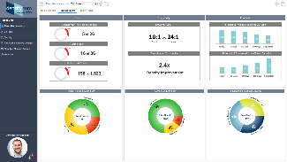




Technical Design – SaaS Implementation
Customer Premises
Densify in SoftLayer
Content Guidance:
In most cases I am assuming that our target GTS audience is most interested in what they need to design and implement within their client’s environment . However they should know enough about the IBM delivery platform to explain it and to understand the integration points into their client environment.
Provide an overview of the technical design of the IBM platform from which this capability is delivered:
Architecture overview sufficient for a GTS Architect to:
Understand how it works and identify any potential issues or conflicts for their client
Be able to explain it to a client
System Context diagram sufficient to identify any potential integration requirements or issues for their client
Describe what other detailed technical work products are available for this capability and where to find them
Installed in 1 VM
Midrange
Connector
vCenter or vROps
Connector
CloudWatch API
Densify Experts
Continuous Expert Insight
and Support
Cloud
Connector
Densification Advisor

Slide 16
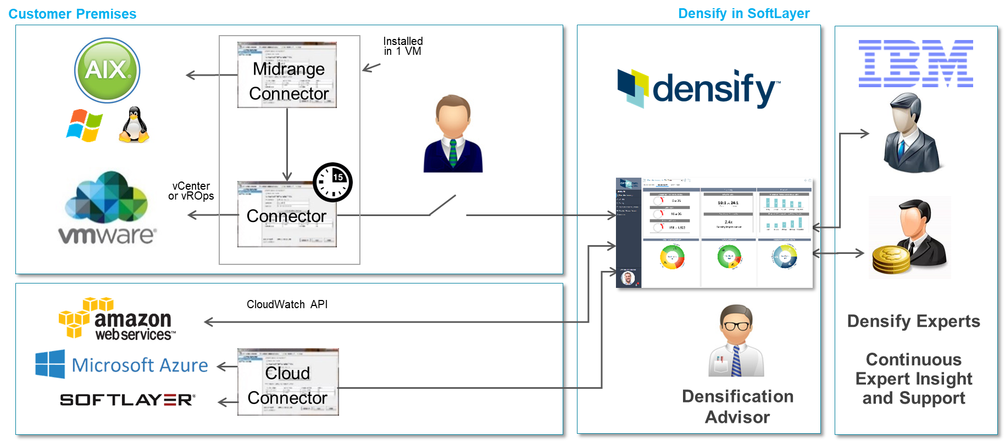
Technical Design – SaaS Implementation
For VMware, Connector collects data from vCentre or vROps using a read only account
The Connector requires a VM with:
2 CPUs, 8GB Memory, 10GB Storage
MS Windows 2012, 2012 R2
PowerVM platform data collection enablement requires guidance from Densify staff
Valid vCenter Server credential to perform VM Moves, Allocation Changes, and DRS setting updates
PowerCLI 6.3 or later
Microsoft PowerShell 3.0 or later
.NET Framework 4.5 or later
For Densify (cross-browser compatible) the following browsers were tested:
Google ChromeTM 52.0 (minimum)
Internet Explorer 11 (Note: With this browser, you must navigate to Tools > Compatibility View Settings and de-select Display intranet sites in Compatibility View)
Microsoft EdgeTM
Safari 9.1.2, 10.0, 10.0.1, 10.0.3
Note: The Control Console is only supported using Internet Explorer 11
Note: A confirmation message to continue is displayed when the browser version differs. The recommendation is to use one of the above browser versions for maximum display and end user experience
Collects utilization data via AWS CloudWatch API for AWS EC2 instances
S3 bucket location for AWS billing data must be provided
Requires appropriate IAM user access keys and key IDs
Contact Densify staff for details on enabling data collection for other public cloud platforms
Your dedicated Densify instance and database are hosted in an environment that provides the following compliance:
SOC 1, SOC 2, SOC 3
PCI Compliance
ISO 27001, 27017, 27018
HIPAA Compliance
CSA STAR Registrant
EU Model Clauses

Slide 17
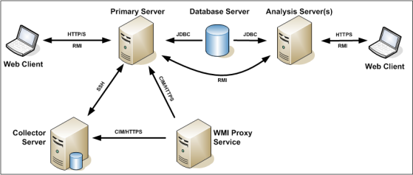
Technical Design – On-Premises Implementation
On Premesis option should only be used where the client requirements require it
At a minimum, at least one Densify primary server is needed, along with a Database, but more depending on HA, DR requirements
Additional Analysis and Collector servers are likely to be required, based on size of environment and network layout
Additional WMI Proxy may also be considered.
Densify require access to the servers to provide their managed service and assist with configuration and analysis of data
On-Premises implementations should be designed with help from Densify

Slide 18
Scoping and Costing Guidance – Standard SaaS implementation
You can activate SDIC by turning ON CIRBA option in SDM, by default it is turned OFF.
Connector instances (VM image) are required for the environments managed (costed separately)
Pricing is based on the number of Targets to be licensed
A Target is defined as any physical or virtual operating system
For example 1 ESX host with 10 VM’s would be considered 11 targets
Minimum 1-year term
Price includes software, implementation services, hosted infrastructure on SoftLayer (excluding Connectors), operations & administration, and ongoing analyst advisor support services
An average of 20% HW Savings can be expected when implementing SDIC in new client environments
For existing client HW Savings can be achieved by allowing more growth without incurring additional HW cost and during refresh. These savings will NOT be reflected in SDM.
Link to the Costing Guidance

Slide 19
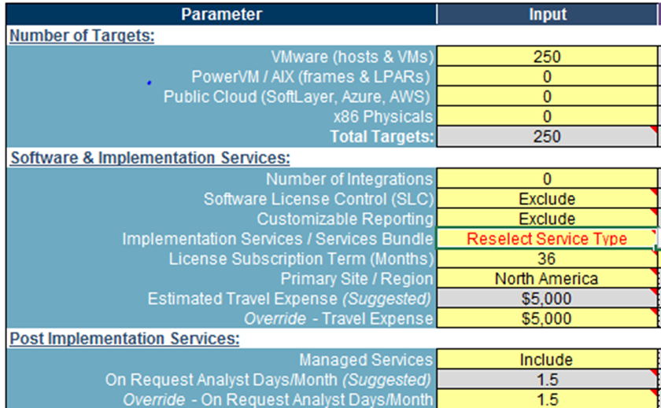
Scoping and Costing Guidance – On Premises
Use the following steps for non standard SDIC solution (e.g. on premises):
Download the Costing Guidance tool.
In the tool, you have to provide inputs to the following sections (see attached diagram):
Number of Targets
Software and Implementation Services
Post Implementation Services
The costing for all software and labour will be generated in the “ROM Pricing” tab.
Request for procurement quotes for recommended infrastructure specifications as provided in the “Infrastructure Sizing Tab”
Steady state labour is provided in the “IBM Labour” tab.
Finally manually transfer all the above cost elements into SDM for pricing purposes
Notes:
(a) For detailed guidance on SDIC costing, refer to the power point presentation imbedded in the Costing Guidance tool.

Slide 20
Implementation Guidance
Suggest starting with VMware initially for quick wins
Later expand to Power Systems, which need a special connector.
Adding public cloud requires additional connectors per cloud
Implement Automation
Finally add physical Intel servers later if needed for Physical to Virtual migration planning or similar

Slide 21
Additional consideration for Automation
Right sizing of VMs may require downtime, needs client approval and raising of change requests.
Adequate change windows are required to test and execute the changes on the server instances
Ensure the client clearly understands the benefits SDIC will bring and the operational changes that are needed to realize the benefits.
Effort will be required for Testing of the changes made in pre-production before moving into Production
Policies will require continuous tweaking as SDIC is not a one off exercise.

Slide 22
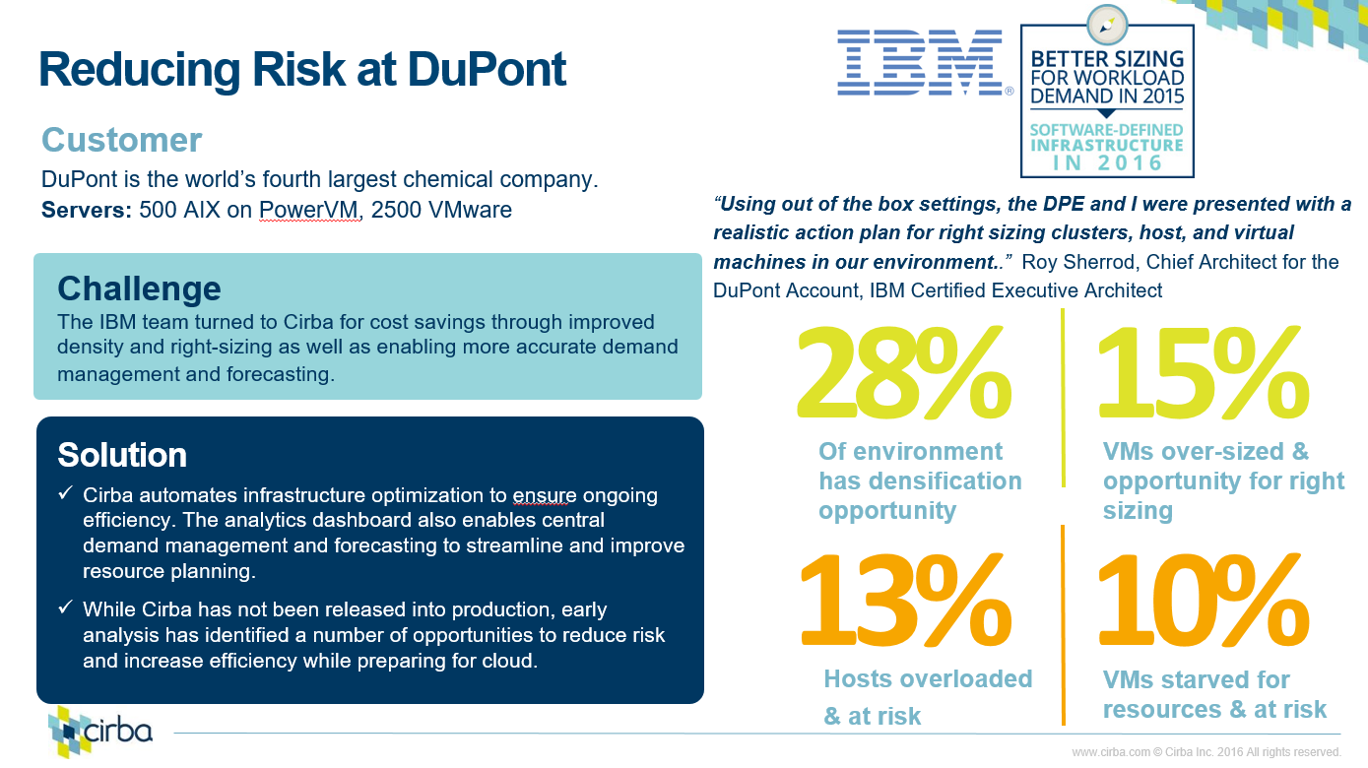

Slide 23
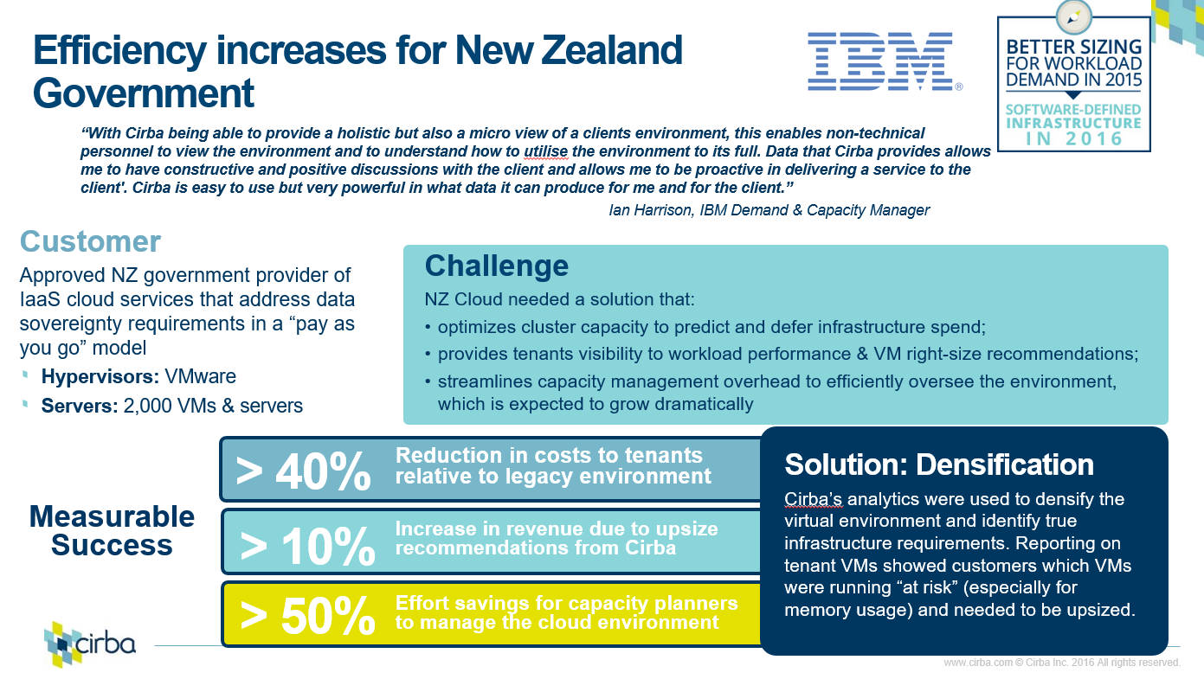

Slide 24
Additional Resources – Supporting Materials
Content Guidance:
Provide descriptions of and pointers what you consider to be the best supporting materials for this capability of offering
Relevant SBBs or GSMs on GDA+
Communities, wikis or fourms providing more detailed or regularly updated content on the offering
Associated asset repositories or information sources
Education and training
Demonstrations or PoC capabilities
etc.
GDA+ SBB (Solution Building Block) for SDIC: https://w3.gsar.ibm.com/services/gsar/gda/sbb_details.xhtml?id=559
Link to SDIC Community: http://ibm.biz/SDIC-Densify
Densify partner portal: https://www.densify.com/partners/portal.html (you will need to register to gain access)
Densify documentation: http://www.densify.com/help/ Use your partner login above to gain access to this
Request a Proof of Concept for your client: http://ibm.biz/SDIC-Trial

Slide 25
Additional Resources – Contacts
Content Guidance:
Identify where or who the Architect can contact to obtain additional information or assistance.
Who are the global and geography contacts for each of the following:
Sales assistance
Solution costing or pricing assistance
Solution technical design assistance
Offering / Service delivery
For each describe their:
Function
Scope (esp. by geography, platform etc.)
Role
Contact Name / Details
Function | Scope | Role / Contact
Lead | Global | Global Lead – Ken Christiance/Raleigh/IBM
Sales | US | US Sales - James Bell/Philadelphia/IBM
Procurement | Global | US/Global Procurement Focal - Rajesh Ramakrishna Dhongadi/India/IBM
Vendor | Densify | Densify Partner Program SVP - Chuck Tatham ctatham@densify.com Director, Business Development, IBM - Brenda Bollinger bbollinger@densify.com Global Sales Director, IBM - Bill Brown bbrown@densify.com

Slide 26
Appendices
Detailed Supporting Information

Slide 27
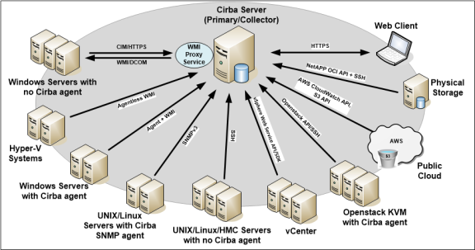
Supporting Information – Communication between Densify Servers and Audit Targets
Densify servers (primary and collector) are capable of auditing managed systems directly using various protocols.
The most common data collection mechanisms and default ports are listed below:
VMware—Port 443 (HTTPS)
Densify SNMP agent—Port 3161 (UDP)
Third-party SNMP agent—Port 161 (UDP)
Densify Windows Agent—Port 7226 (TCP)
SSH-based audit of UNIX servers—Port 22 (TCP)
Densify WMI Proxy—Port 7224 (non-secure) or 7225 (secure)
Note: These default ports are configurable.
More communication details are available at: http://www.densify.com/help/10.0.0/Content/Infrastructure_Requirements/Additional_Considerations.htm

Slide 28
Supporting Information - FrameworkBlue
 | North America | Europe | Asia Pacific | Latin America | Japan
Stage 4: Software Defined Infrastructure Control | (2098) v74_0 | (2069) V74_0 | (2069) V74_0 | (2069) V74_0 | (2069) V74_0
Release status in above table
SDIC Savings for IBM owned HW – Guidance of 20% savings on Hypervisor; Alternate upsell offering for client retained HW/SW. For next FwB, will work with Global SLE for potential efficiency (25%) on DS perf/cap
Addiitonal Cost Guidance
VMWare
Linear; (31.599x+21567 [x=server volume]) / 12 months
PowerVM/AIX and Non Virt Win/Linux x86
Power Curve; (416.44x^0.7712 [x=server volume]) / 12 months
Min commit volume = 250 servers
Startup cost
Rate includes Cirba professional services

Slide 29
SDIC – Prerequisite Checklist
Terms & Conditions & Prerequisites
FwB solution for Densify (aka Cirba) assumes SaaS option, where a lightweight connector is deployed on client premise and collected utilization/config data is sent to BlueMix/Softayer for analytics and reporting. Data transport is via secure SSH/443 (configurable port), and client environments within the SaaS are dedicated per client - no multi-tenant. For dedicated on premise deployment, custom pricing is available
Supported Environments
VMWare, PowerVM/AIX, Non virtual x86 windows and Linux, AWS Cloud, Azure Cloud & Softlayer Cloud. Note: additional platforms (eg. Openstack, HyperV are supported in dedicated on premise model)
Prerequisites
VM spec for: Vmware Connector and the Midrange Connector - Example for 1500 system env: 4 CPU, 16 GB RAM, 64 GB (30 GB for Densify and 34 GB for OS/DB) - Detailed sizing provided as part of baseline review) - Note additional Connectors could be required to address latency, firewalls, physical locations, time zones, etc.
Microsoft Windows Server 2012 or 2012 R2; SQL Express (Required for PowerVM/AIX and non virtual x86; not required for VMWare); Other requirements for the VM:; HTTPS port 443 (configurable); Access from the VM to the systems in scope for data collection; Access to the internet; VPN Access to the Midrange Connector for Densify Operations Team
Implications:
Densify supports automation transition from manual to fully automated; The densification advisor that is included in the SaaS will guide the journey to Software Defined Infrastructure Control on every step. Value benefits are realized when actions are performed (manually or automated) based on the insights.. Tangible benefits are improved density of hypervisor environments in range of >20%. Refinement of benefits and ROI can be obtained via analysis of client environment on short timeframe PoC (30day)

Slide 30
SDIC – Prerequisite Checklist (cont)
Data collection Prerequisites
VMWare: vCenter Server 5.1, 5.5 or 6.0; Optionally - vRealize Operation Manager (vROps) 6.1 or later; Non-expiring login credentials (read only to start) for vCenter and vROp(Note will need read/write vCenter access for action automation)s; The accounts must have visibility to the all clusters/hosts/VMs in scope; If vROps is not in scope, additional vCenter setting required - 5 minute workload statistics level is set to 2
PowerVM/AIX: HMC Pre-requisites: SSH configured and enabled; Non-expiring, non-root, SSH account with hmcviewer role; The account must have visibility to all server farms/frames/LPARs in scope;
PowerVM/AIX LPAR Pre-requisites: HMC 8 or later, SSH configured and enabled; LPAR authentication methods include PKI or username/password; A service account on all LPARs with the following capabilities:; Access to vmstat, iostat and lparstat (must be installed on each LPAR); Write access to cron available; Write access to /var/tmp and /tmp; Additional tools on all LPARs; bos.perf.libperfstat; gzip (if gzip is installed the data will automatically be compressed and encrypted; otherwise, data is transferred uncompressed over a secure channel).; A local working directory with 30MB of free space for workload collection ; by default, /var/tmp is used (configurable)
Non Virtual Windows; Agentless (preferred) and agent options available; Agentless prerequisites: Non-expiring Domain or Local Administrator service account with remote WMI privileges & have privileges to: Connect to the Windows targets remotely; Access the WMI Namespace; Communicate through the DCOM ports; .NET version 3.5.1 on servers running the WMI Proxy service ; Proxy will be running on the Midrange Connector; Windows Management Instrumentation (WMI) installed on each target physical server and the WMI service running; Port 135 open on each target physical server to communicate with the proxy for initial connection; Random port from 1024 to 65535 for subsequent connections; Agent prerequisites available on request
Non Virtual Linux; Agentless (preferred) and agent options available; Agentless prerequisites:; SSH configured and enabled; Authentication methods include PKI or username/password; If username/password authentication is used, then a non-expiring, non-root SSH account; The account must have the following capabilities:; Access to vmstat, iostat; Write access to cron; Write access to /var/tmp and /tmp; gzip (if gzip is installed the data will automatically be compressed and encrypted; otherwise, data is transferred uncompressed over a secure channel).; A local working directory with 30MB of free space for workload collection ; by default, /var/tmp is used (configurable); Agent prerequisites available on request
Cloud prerequisites available on request

Slide 31

Thank you!
For more information, please visit:
http://www.ibm.com

